Slide 1
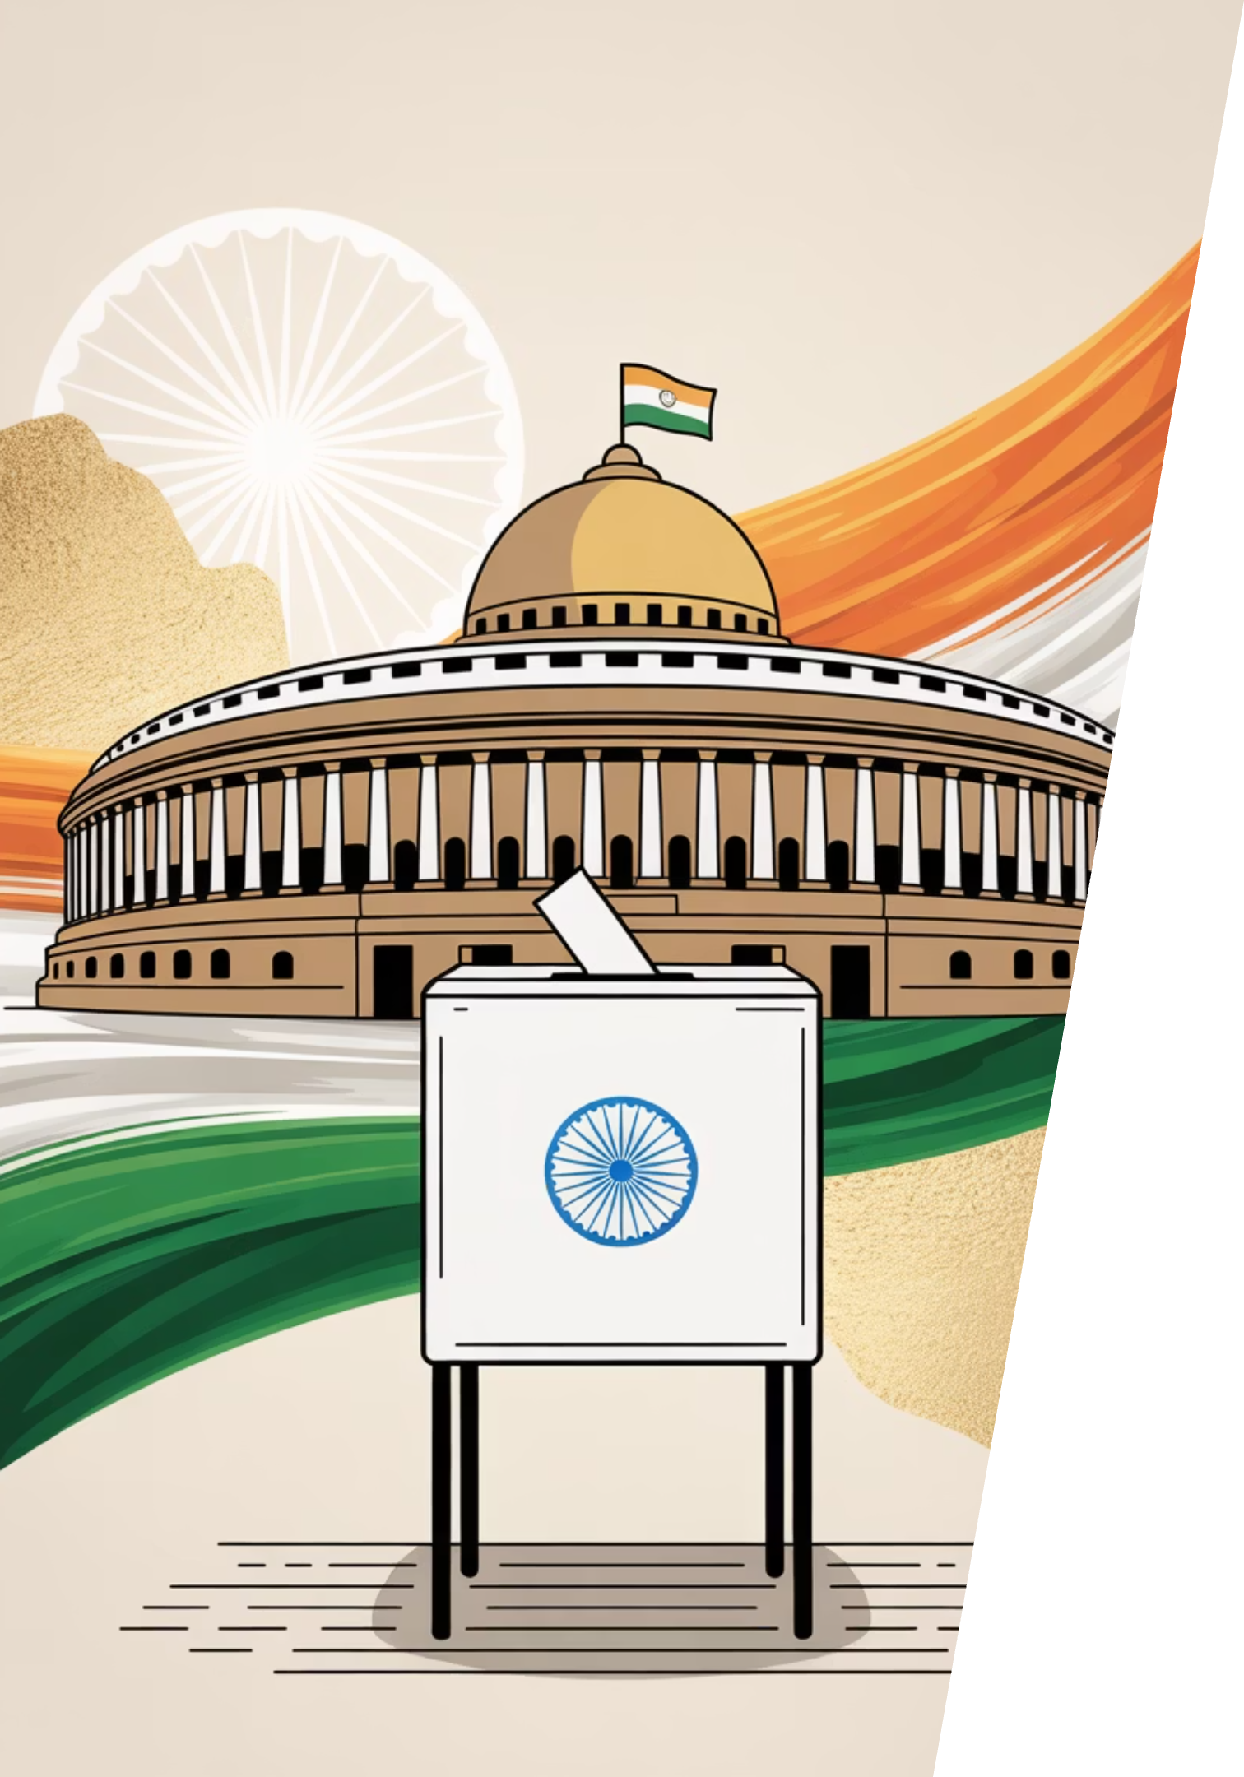

ElectViz – Election Data Visualization for Media
A comprehensive Power BI solution for analyzing electoral trends, party performance, and voter behaviour across India's democratic landscape (2009-2021)
POWER BI
2009-2021
Creator: SHARMIKA SHRI R
Mentor: Mrs.Nithyasri S.J

Slide 3
PROJECT OVERVIEW
Understanding India's Electoral Complexity
Scale of Indian Elections
Traditional Challenges
ElectViz Solution
India's elections represent one of the world's largest democratic exercises, generating massive datasets encompassing thousands of candidates, multiple political parties, diverse constituencies, and millions of votes cast across varied demographics.
Traditional analytical methods struggle with this scale and complexity, making it difficult to extract meaningful patterns and insights from raw electoral data.
ElectViz transforms this challenge into opportunity through interactive visualization, enabling stakeholders to quickly understand party performance trends, voter turnout patterns, demographic shifts, and constituency-level outcomes with clarity and precision.

Slide 4





TECHNICAL APPROACH
System Design and Data Workflow
Data Collection
Structured datasets spanning multiple election cycles, covering candidates, parties, constituencies, and voting statistics
Data Preparation
Cleaning and standardization processes to eliminate inconsistencies, handle missing values, and ensure data quality using power query editor in PowerBI.
Data Modeling
Creating relationships between entities—candidates, parties, states, constituencies, and election years for comprehensive analysis
Metric Calculation
DAX formulas computing vote share percentages, seats won, voter turnout rates, and winning margin statistics
Dashboard Development
Interactive visualizations using charts, maps, KPIs, and dynamic slicers enabling multi-dimensional exploration

Slide 5
Dashboard Features and Capabilities
Party Performance Analysis
Geographic Visualization
Demographic Insights
Trend Identification
Year-over-year comparisons showing electoral shifts, winning margins, and participation rates
Track seats won and vote share percentages across multiple parties and election cycles
State-wise electoral maps revealing regional voting patterns and constituency distributions
Gender distribution of candidates and voting behavior analysis across different demographic segments
Transforming Data into Understanding
Clear visualization of complex electoral dynamics across multiple dimensions
State-level and party-level performance comparisons enabling strategic analysis
Demographic patterns revealing candidate diversity and representation trends
Interactive filtering allowing customized views for specific research questions
Temporal trend analysis showcasing electoral evolution over 13 years

Slide 6
Key Findings and Insights
Scale of Elections
Voter Participation
Party Dominance
The dashboard analyzes Indian election data from 2009 to 2021, covering more than 4,000 constituencies across the country. A total of 91,000+ candidates participated in the elections.
The total number of votes recorded is approximately 1.53 billion, showing strong voter participation.
BJP and INC emerge as the dominant parties in terms of total seats won over multiple election cycles. Vote share analysis highlights close competition among major parties.
Candidate Demographics
Electoral Trends
Middle-aged candidates have won the highest number of seats. Male candidates form the majority, with significantly lower female participation.
State-wise voter turnout varies widely. Trend analysis reveals fluctuations in winning margins and close contests, indicating increasing electoral competitiveness.

Slide 7
FUTURE ROADMAP
Future Enhancements
Real-time Data Integration
1
Connect live election data feeds for immediate analysis during active electoral cycles
Predictive Analytics
2
Implement machine learning algorithms to forecast election outcomes based on historical patterns
Enhanced Candidate Profiles
3
Incorporate additional dimensions including educational backgrounds, criminal records, and asset declarations
Constituency Deep-dive
4
Enable granular drill-down analysis to individual constituency level with voter demographics
Cloud Deployment
5
Publish through Power BI Service for broader accessibility and collaborative analysis capabilities

Slide 8

PROJECT CONCLUSION
Conclusion
Complex to Clear
Complex to Clear
Comprehensive Vision
Successfully transformed intricate electoral datasets into accessible, actionable insights
Successfully transformed intricate electoral datasets into accessible, actionable insights
Delivered holistic view of party performance, voter behaviour, and demographic patterns
Interactive Intelligence
Proven Approach
Enhanced cross-state and multi-year comparisons through dynamic, user-driven exploration
Demonstrated Power BI's effectiveness for large-scale political data analysis and visualization

Slide 9
Thank You
Questions & Discussion
We welcome your insights and queries about ElectViz and its applications in electoral data analysis.
CONTACT
DOCUMENTATION
FEEDBACK

